Slide 1
American Government A-203 Mr. Dye

Slide 2
Classroom Rules 1. Be On Time 2. Be Prepared for Class 3. Be Respectful of Others 4. No Food or Drink (except water)

Slide 3
American Government

Slide 4
What does it mean to be a good citizen?
List three things, one on each piece of paper

Slide 5
What is the difference between…
Civic Duties Civic Responsibilities

Slide 6
Civic Duties
Civic Responsibilities
Things we have to do
Things we should do

Slide 7
Personal Dictionary
Academic Term
Personal Illustration
Citizen
Personal Connection
Personal Definition

Slide 8
Review Terms
Citizen
Civic Duty
Civic Responsibility

Slide 9
Are you a citizen?
How do you become a citizen?

Slide 10
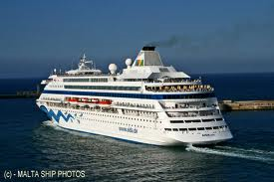
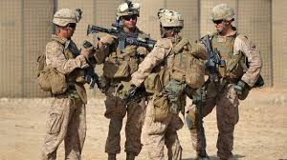
Are you a US Citizen if you are born when….
your parents are US citizens on a cruise in the middle of the ocean?
your parents are US government workers and are stationed in Afghanistan?
2 U.S. Parents = 1 U.S. Baby

Slide 11
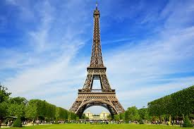
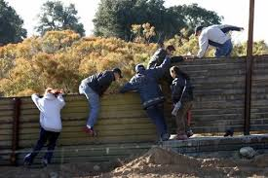
Are you a US Citizen if you are born when….
One parent is a US citizen while the other is French and they are in France?
Duel citizenship
Neither parent is a US citizen but they are in the United States

Slide 12
Are you a citizen?
How do you become a citizen?
1. Birth
2. Naturalization
3. Marriage

Slide 13
What are Immigrants?
Where do they come from?
What or who are they?
Do they still exist today?

Slide 14
Migration vs. Immigration
What is the meaning of these words?
Are there any differences? If so, what are they?

Slide 15
Meaning
Migration – Move from something / Move away from something.
Immigration – Move to something.
What is the difference?

Slide 16
Exit Ticket-Given to me
before you leave
How can you be a better citizen?

