Slide 1
Voting and Elections
Who was allowed in Colonial America?
21yrs old
White Male
Citizens
Land Owners

Slide 2
Voting and Elections
Today who can vote?
Who can’t vote?
18 yrs old
Citizen
Registered
Voter
Convicted
felons serving
time
2. Non-citizen

Slide 3
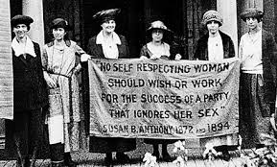
Which groups have gained the right to vote?
African Americans/minorities
As a result of the 15th Amendment and the 24th Amendment banning Poll tax
Women
As a result of the 19th Amendment

Slide 4
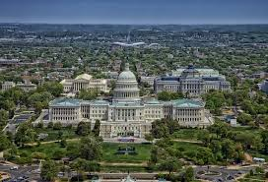
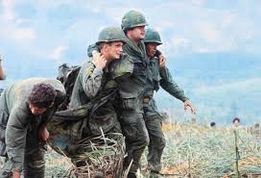
Which groups have gained the right to vote?
Residents of Washington DC
18 yrs olds
As a result of the 26th Amendment
As a result of the 23rd Amendment

Slide 5
Vocab Terms
Ballot - a process of voting, in writing and typically in secret.
Exit Poll - a poll of people leaving a polling place, asking how they voted.
Apathy - lack of interest, enthusiasm, or concern.
Precinct - a district of a city or town as defined for voting purposes.

